Slide 1

8 Week SQL Challenge
Case Study #2 Pizza Runner

Slide 2
Introduction
Did you know that over 115 million kilograms of pizza is consumed daily worldwide??? (Well according to Wikipedia anyway…)
Danny was scrolling through his Instagram feed when something really caught his eye - “80s Retro Styling and Pizza Is The Future!”
Danny was sold on the idea, but he knew that pizza alone was not going to help him get seed funding to expand his new Pizza Empire - so he had one more genius idea to combine with it - he was going to Uberize it - and so Pizza Runner was launched!
Danny started by recruiting “runners” to deliver fresh pizza from Pizza Runner Headquarters (otherwise known as Danny’s house) and also maxed out his credit card to pay freelance developers to build a mobile app to accept orders from customers.

Slide 3
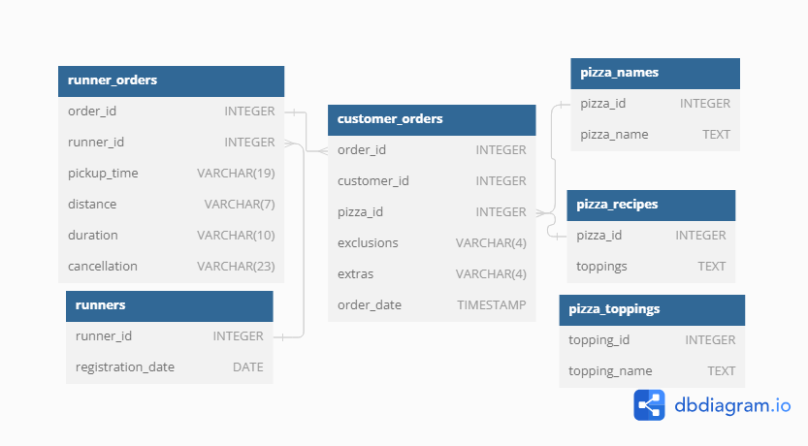
Entity Relationship Diagram

Slide 4
Case Study Questions
A. Pizza Metrics
How many pizzas were ordered?
How many unique customer orders were made?
How many successful orders were delivered by each runner?
How many of each type of pizza was delivered?
How many Vegetarian and Meatlovers were ordered by each customer?
What was the maximum number of pizzas delivered in a single order?
For each customer, how many delivered pizzas had at least 1 change and how many had no changes?
How many pizzas were delivered that had both exclusions and extras?
What was the total volume of pizzas ordered for each hour of the day?
What was the volume of orders for each day of the week?

Slide 5
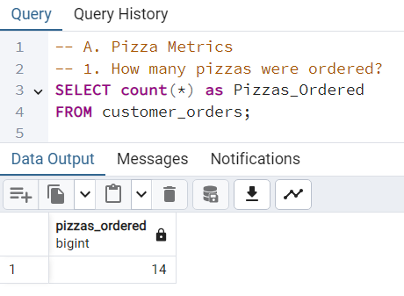
1. How many pizzas were ordered?

Slide 6
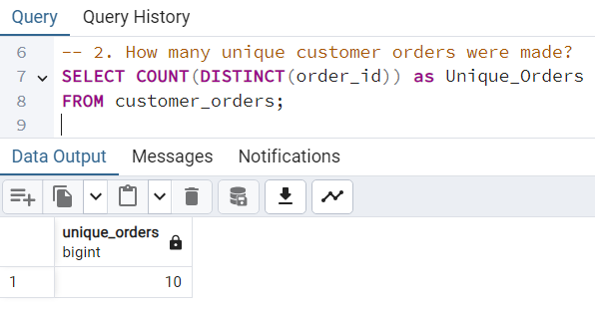
2. How many unique customer orders were made?

Slide 7
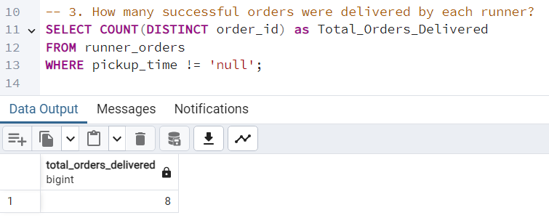
3. How many successful orders were delivered by each runner?

Slide 8
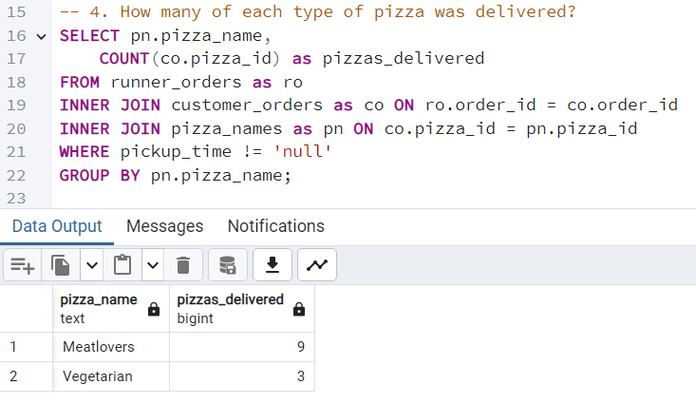
4. How many of each type of pizza was delivered?

Slide 9
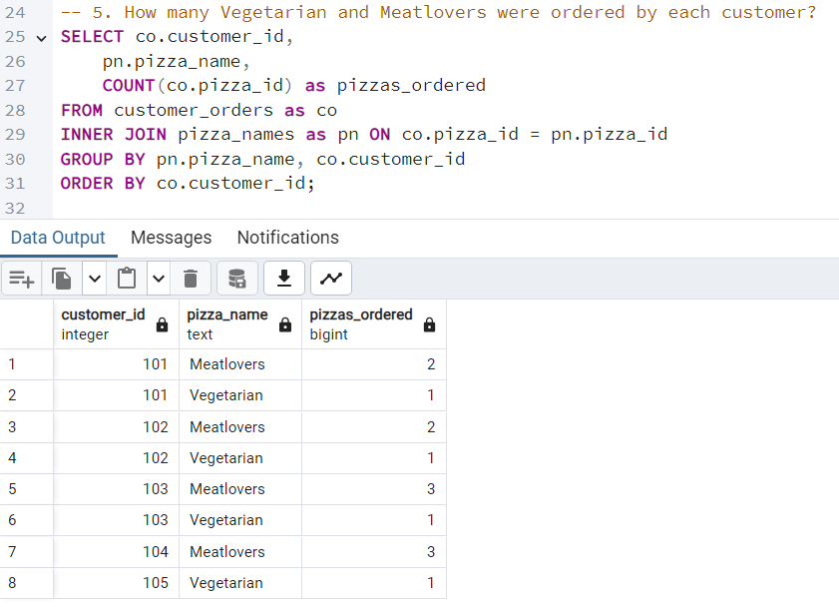
5. How many Vegetarian and Meat lovers were ordered by each customer?

Slide 10
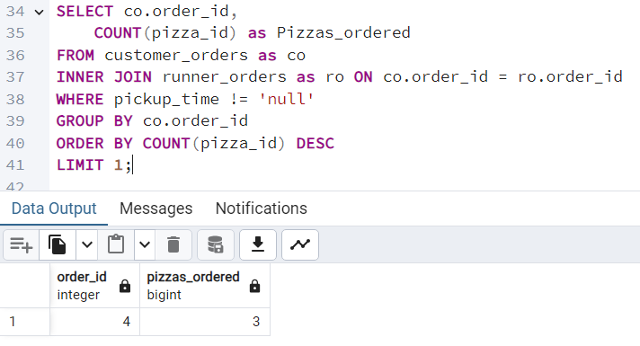
6. What was the maximum number of pizzas delivered in a single order?

Slide 11
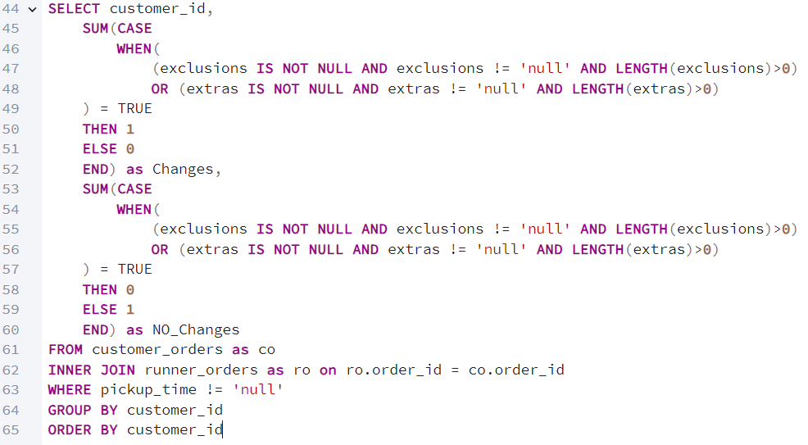
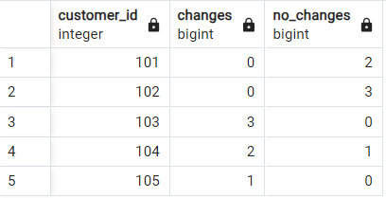
7. For each customer, how many delivered pizzas had at least 1 change and how many had no changes?

Slide 12
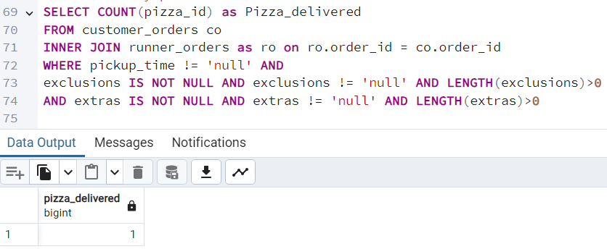
8. How many pizzas were delivered that had both exclusions and extras?

Slide 13
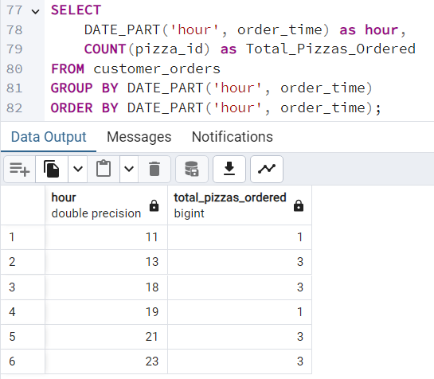
9. What was the total volume of pizzas ordered for each hour of the day?

Slide 14
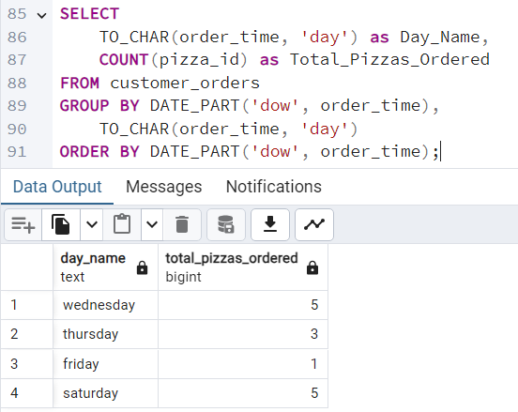
10. What was the volume of orders for each day of the week?

Slide 15
B. Runner and Customer Experience
How many runners signed up for each 1 week period? (i.e. week starts 2021-01-01)
What was the average time in minutes it took for each runner to arrive at the Pizza Runner HQ to pickup the order?
Is there any relationship between the number of pizzas and how long the order takes to prepare?
What was the average distance travelled for each customer?
What was the difference between the longest and shortest delivery times for all orders?
What was the average speed for each runner for each delivery and do you notice any trend for these values?
What is the successful delivery percentage for each runner?

Slide 16
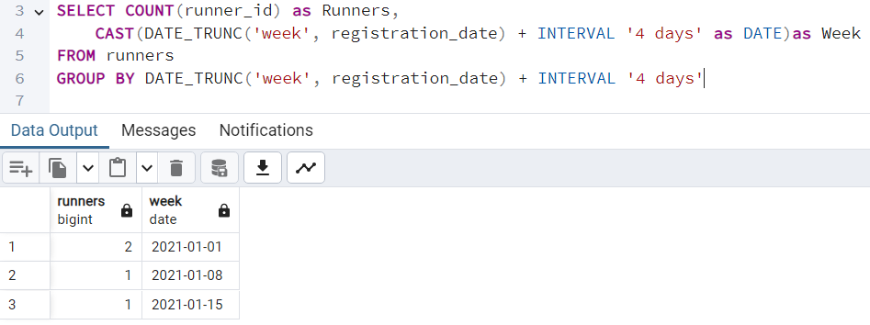
1. How many runners signed up for each 1 week period? (i.e. week starts 2021-01-01)

Slide 17
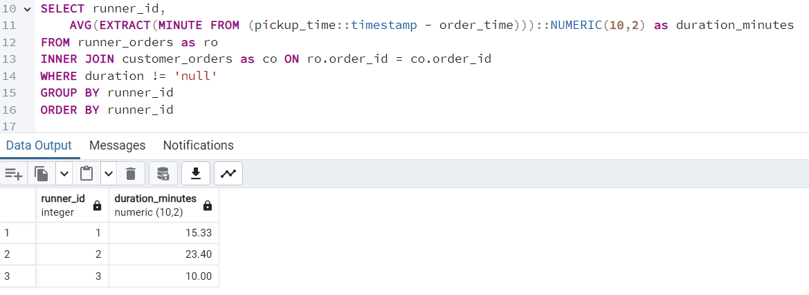
2. What was the average time in minutes it took for each runner to arrive at the Pizza Runner HQ to pickup the order?

Slide 18
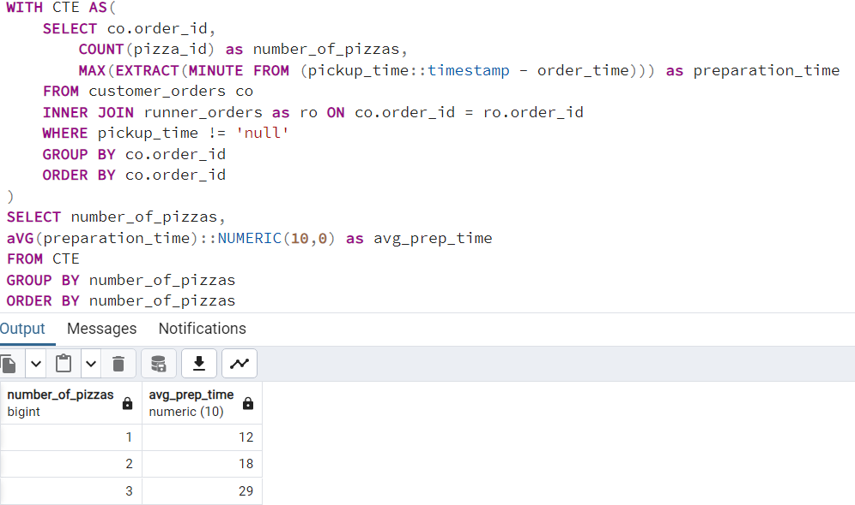
3. Is there any relationship between the number of pizzas and how long the order takes to prepare?
Average Time taken to prepare
one pizza is 12minutes
Two pizza is 18minutes
Three pizza is 29minutes

Slide 19
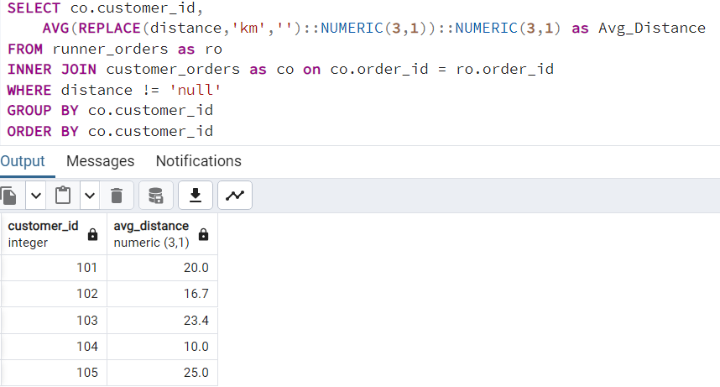
4. What was the average distance travelled for each customer?

Slide 20
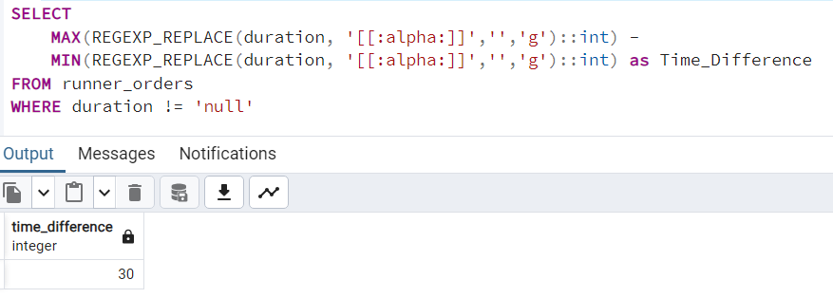
5. What was the difference between the longest and shortest delivery times for all orders?

Slide 21
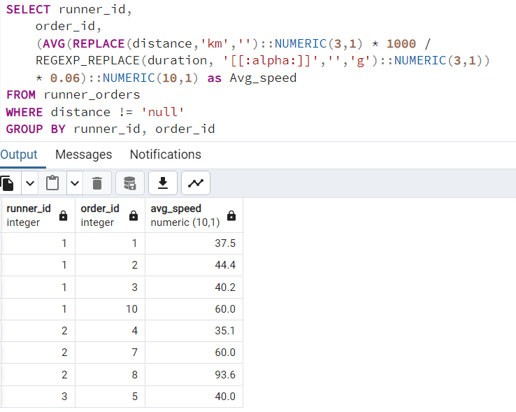
6. What was the average speed for each runner for each delivery and do you notice any trend for these values?
An observed trend is that as runners do more deliveries, they get faster.

Slide 22
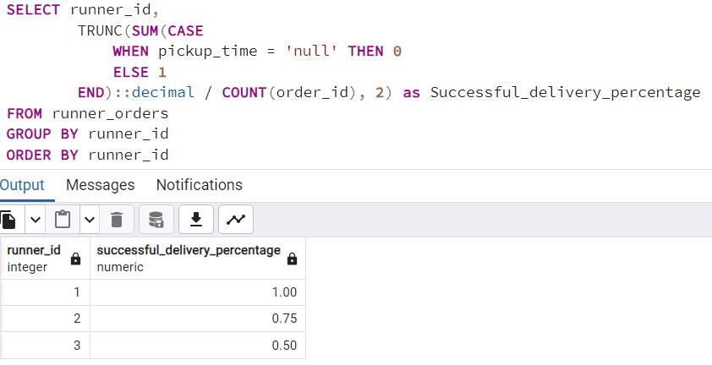
7. What is the successful delivery percentage for each runner?
Runner ID 1
Successful Delivery Percentage is 100%
Runner ID 2
Successful Delivery Percentage is 75%
Runner ID 3
Successful Delivery Percentage is 50%

Slide 23
C. Ingredient Optimisation
What are the standard ingredients for each pizza?
What was the most commonly added extra?
What was the most common exclusion?
Generate an order item for each record in the customers_orders table in the format of one of the following:
Meat Lovers
Meat Lovers - Exclude Beef
Meat Lovers - Extra Bacon
Meat Lovers - Exclude Cheese, Bacon - Extra Mushroom, Peppers
Generate an alphabetically ordered comma separated ingredient list for each pizza order from the customer_orders table and add a 2x in front of any relevant ingredients
For example: "Meat Lovers: 2xBacon, Beef, ... , Salami"
What is the total quantity of each ingredient used in all delivered pizzas sorted by most frequent first?

Slide 24
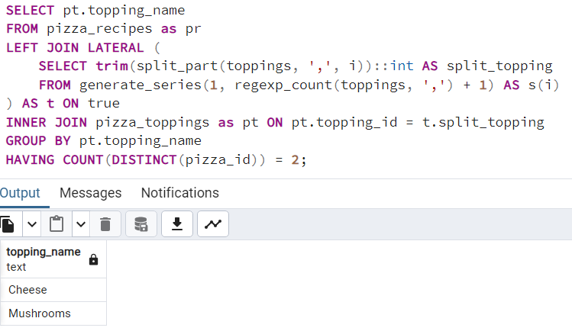
1. What are the standard ingredients for each pizza?
The most standard ingredients used in both pizzas are
Cheese
Mushrooms

Slide 25
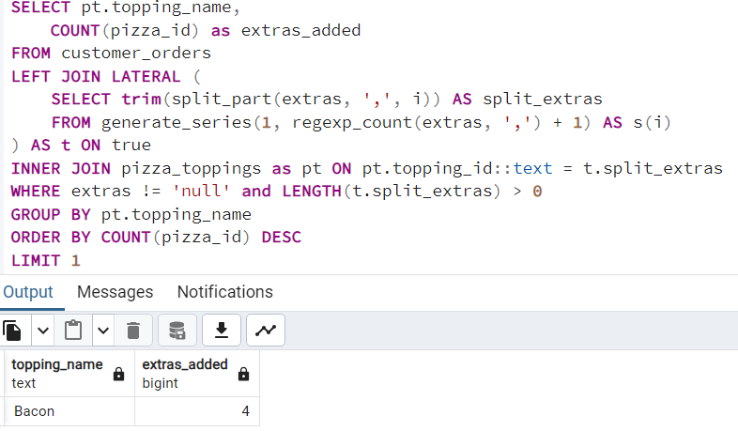
2. What was the most commonly added extra?
Bacon is the most commonly added extra.

Slide 26
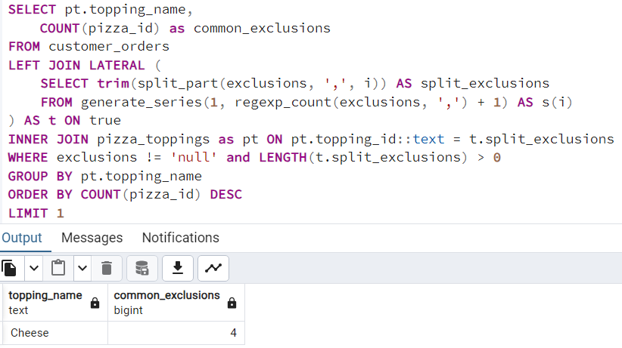
3. What was the most common exclusion?
Most Common Exclusion is Cheese

Slide 27
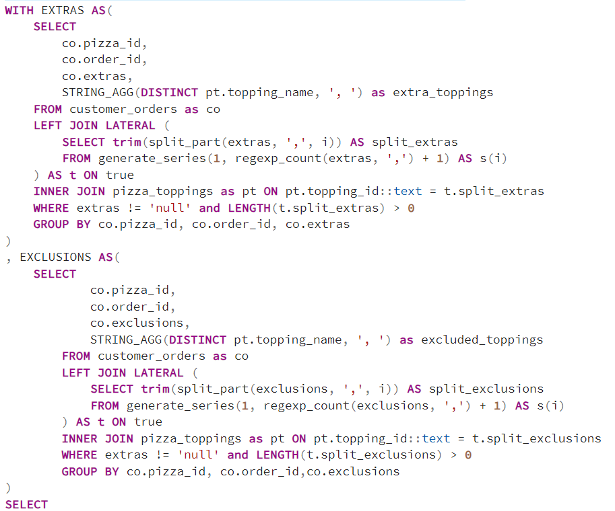
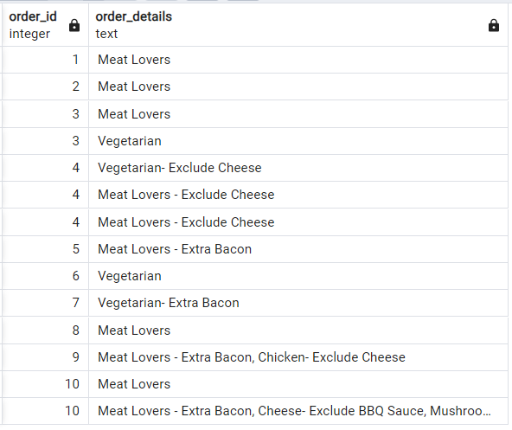
4. Generate an order item for each record in the customers_orders table in the format of one of the following: Meat Lovers Meat Lovers - Exclude Beef Meat Lovers - Extra Bacon Meat Lovers - Exclude Cheese, Bacon - Extra Mushroom, Peppers

Slide 28
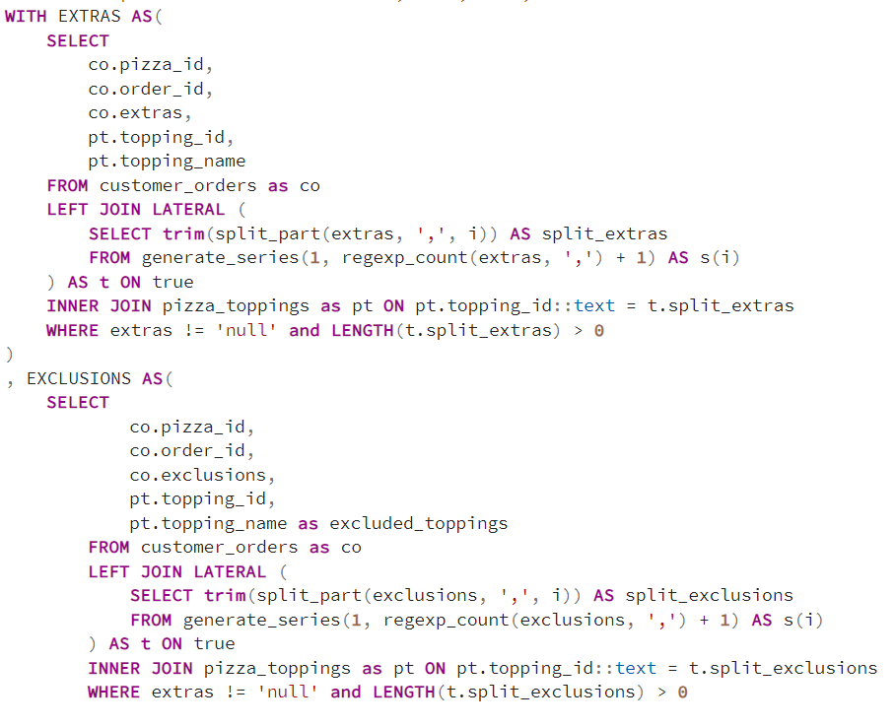
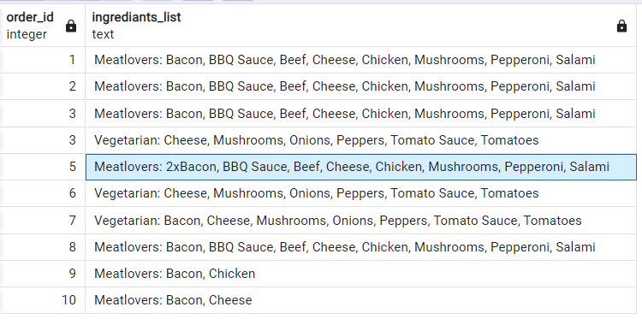
5. Generate an alphabetically ordered comma separated ingredient list for each pizza order from the customer_orders table and add a 2x in front of any relevant ingredients For example: "Meat Lovers: 2xBacon, Beef, ... , Salami"

Slide 29
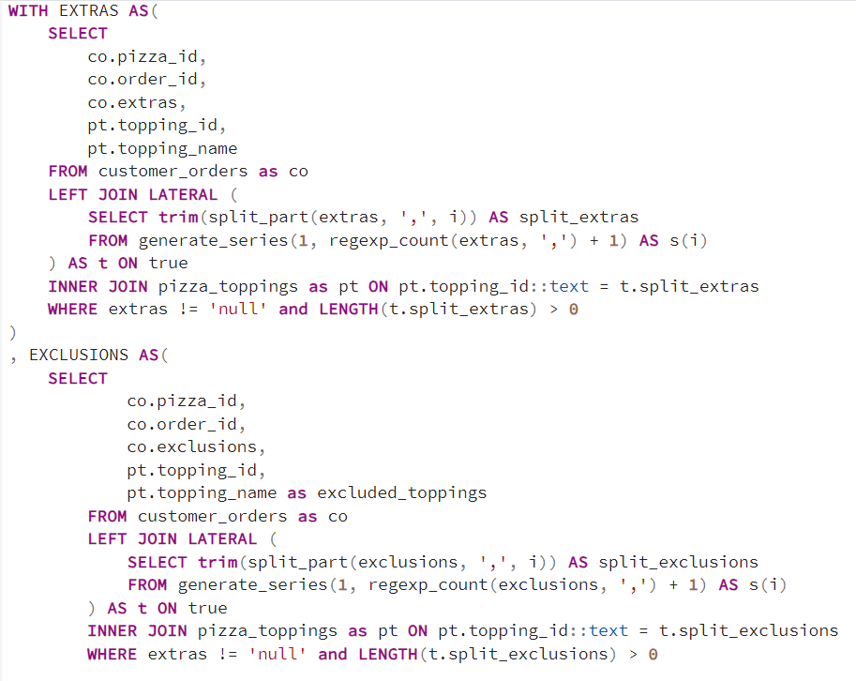
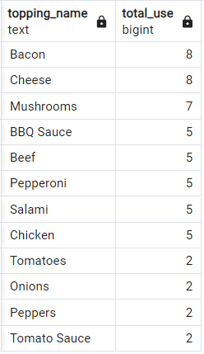
6. What is the total quantity of each ingredient used in all delivered pizzas sorted by most frequent first?

Slide 30
D. Pricing and Ratings
If a Meat Lovers pizza costs $12 and Vegetarian costs $10 and there were no charges for changes - how much money has Pizza Runner made so far if there are no delivery fees?
What if there was an additional $1 charge for any pizza extras?
Add cheese is $1 extra
The Pizza Runner team now wants to add an additional ratings system that allows customers to rate their runner, how would you design an additional table for this new dataset - generate a schema for this new table and insert your own data for ratings for each successful customer order between 1 to 5.
Using your newly generated table - can you join all of the information together to form a table which has the following information for successful deliveries?
customer_id
order_id
runner_id
rating
order_time
pickup_time
Time between order and pickup
Delivery duration
Average speed
Total number of pizzas
If a Meat Lovers pizza was $12 and Vegetarian $10 fixed prices with no cost for extras and each runner is paid $0.30 per kilometre traveled - how much money does Pizza Runner have left over after these deliveries?

Slide 31
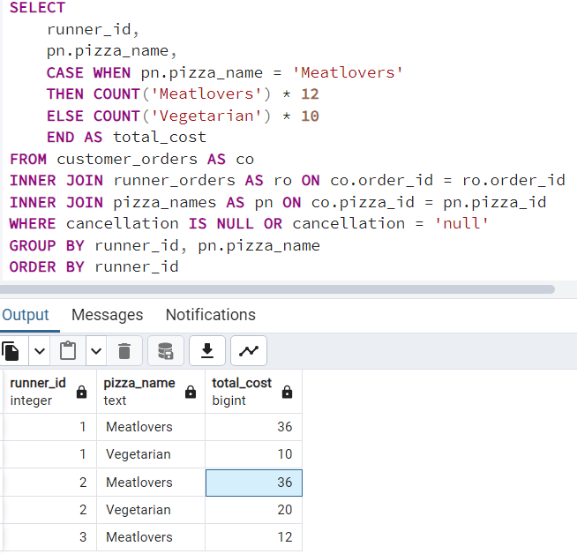
1. If a Meat Lovers pizza costs $12 and Vegetarian costs $10 and there were no charges for changes how much money has Pizza Runner made so far if there are no delivery fees?
Runner id 1 totally made $46
Runner id 2 totally made $56
Runner id 3 totally made $12

Slide 32
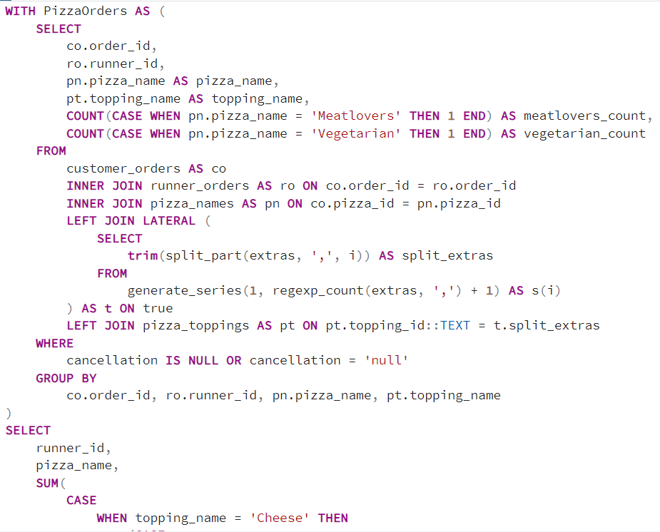
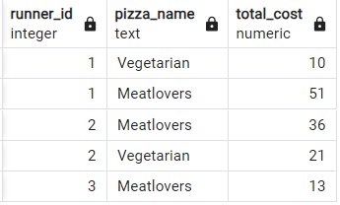
2. What if there was an additional $1 charge for any pizza extras? Add cheese is $1 extra

Slide 33
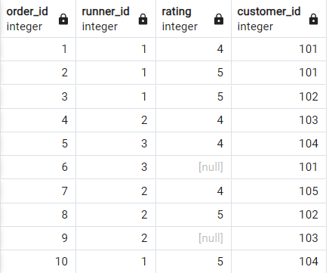
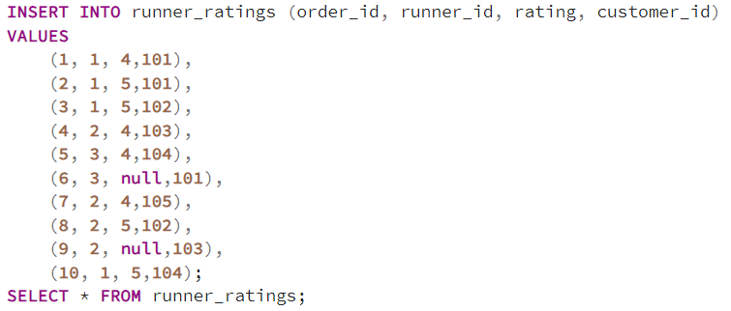
3. The Pizza Runner team now wants to add an additional ratings system that allows customers to rate their runner, how would you design an additional table for this new dataset generate a schema for this new table and insert your own data for ratings for each successful customer order between 1 to 5.

Slide 34
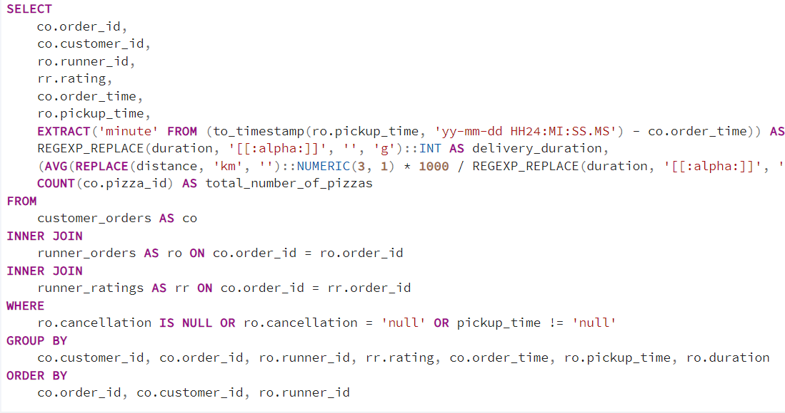
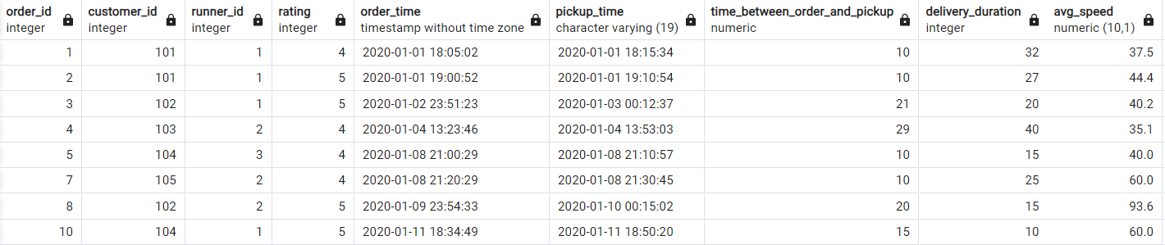
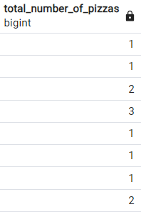
4. Using your newly generated table - can you join all of the information together to form a table -- which has the following information for successful deliveries?

Slide 35
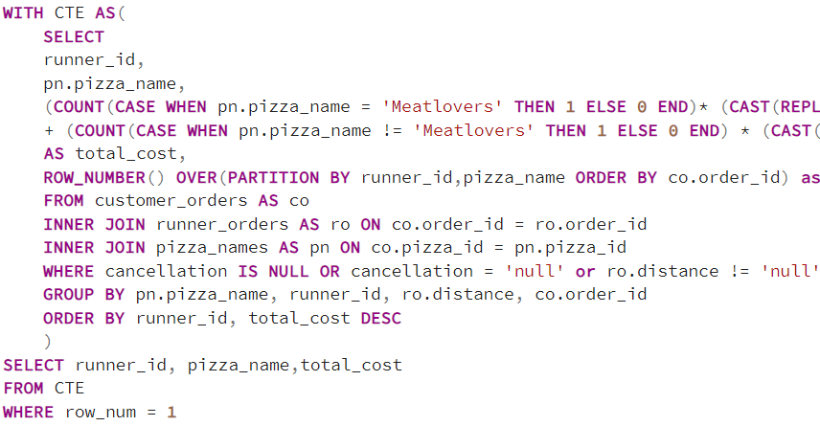
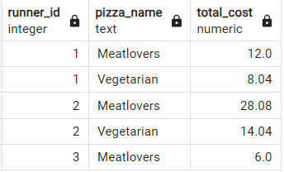
5. If a Meat Lovers pizza was $12 and Vegetarian $10 fixed prices with no cost for extras and each runner is paid $0.30 per kilometer traveled how much money does Pizza Runner have left over after these deliveries?

